Slide 1

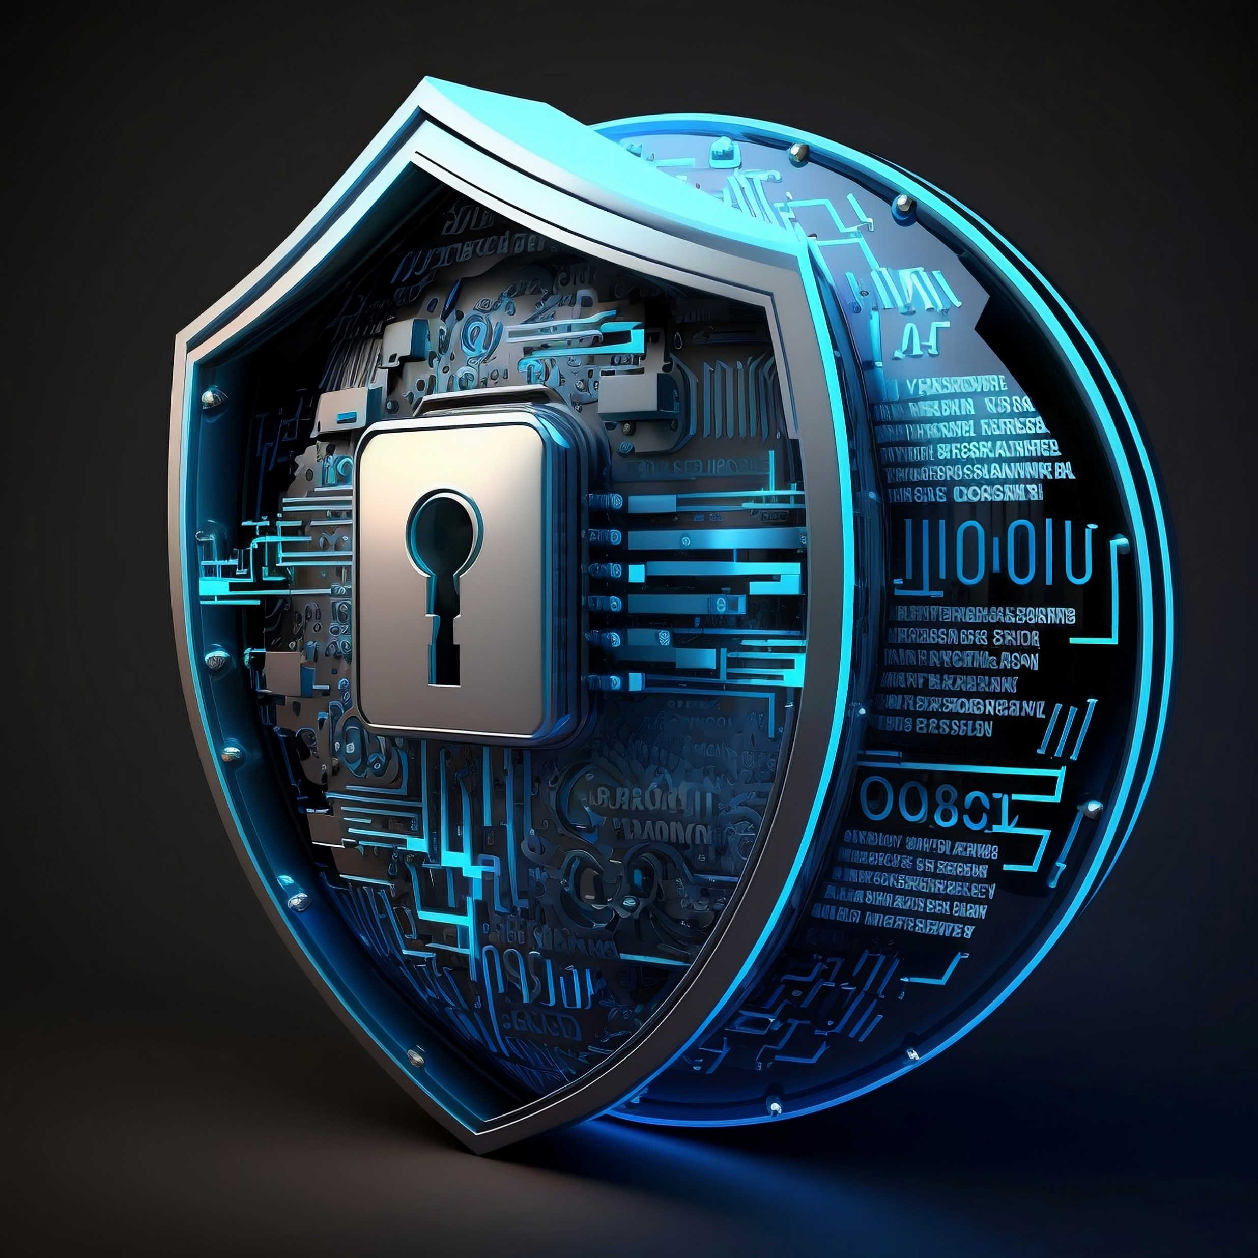

Malware
Malicious software that compromises computer systems.

Slide 2
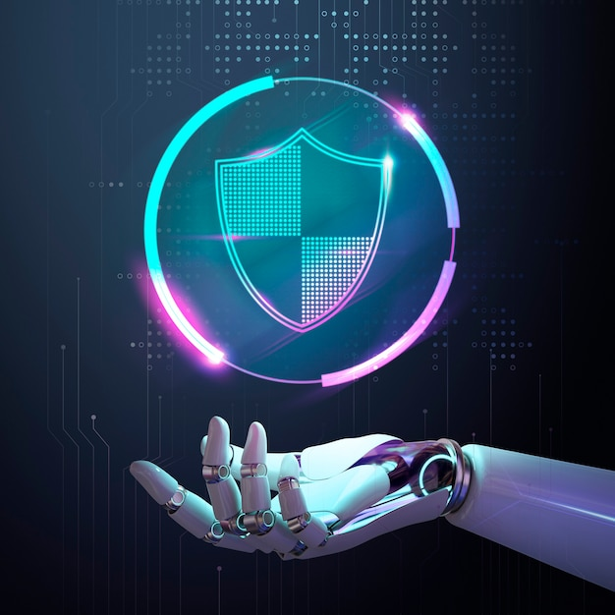
Malware
Malware, short for malicious software, refers to any software specifically designed to harm or exploit computer systems, steal data, disrupt operations, or gain unauthorized access. It poses a significant threat to cybersecurity.

Slide 3
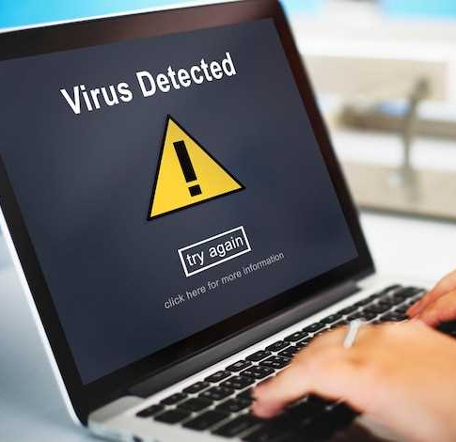
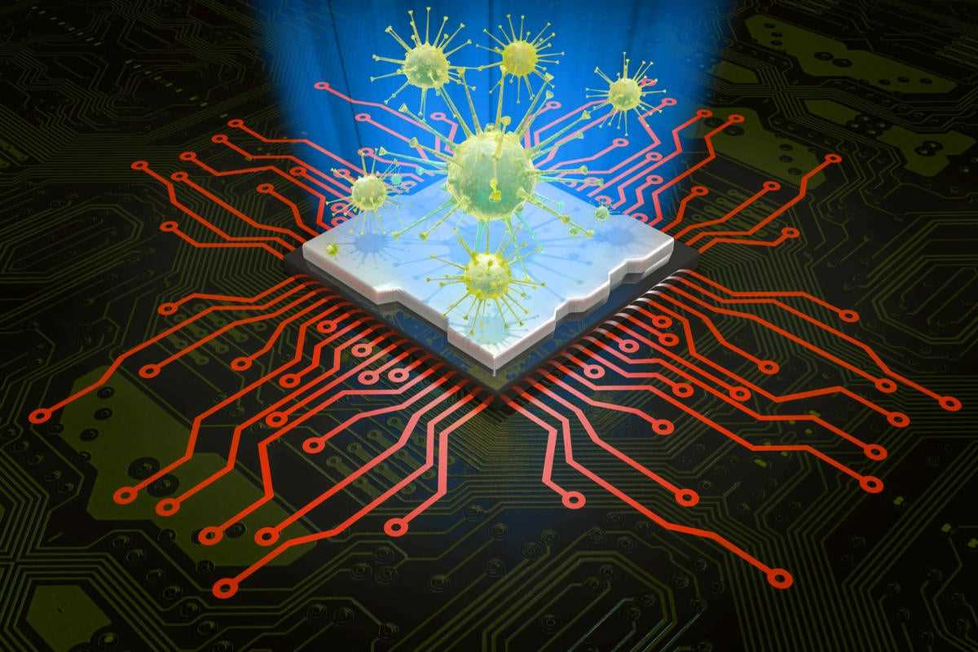
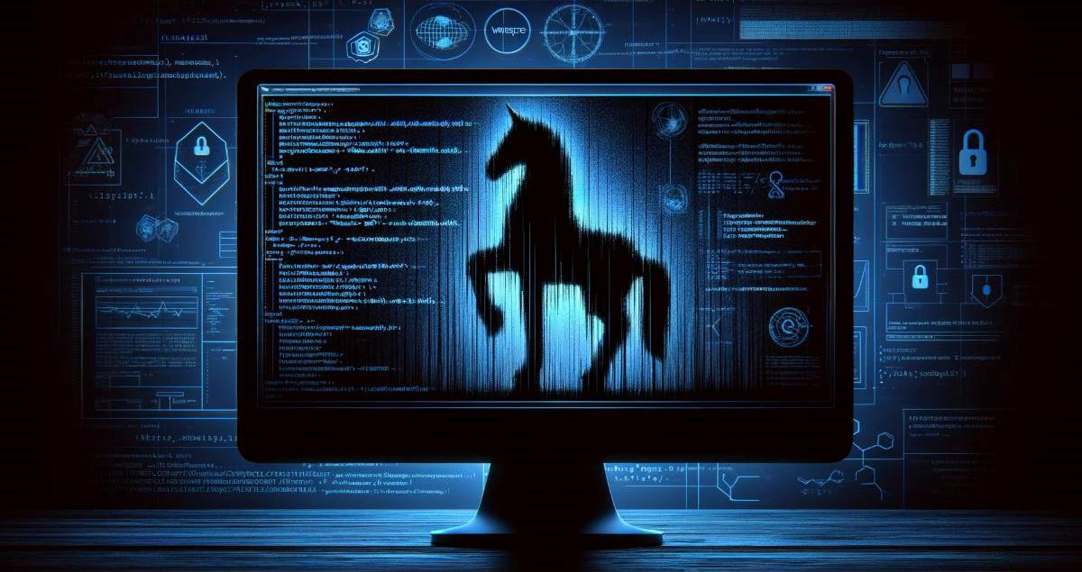
Types Of Malware
Viruses
Worms
Trojans

Slide 4
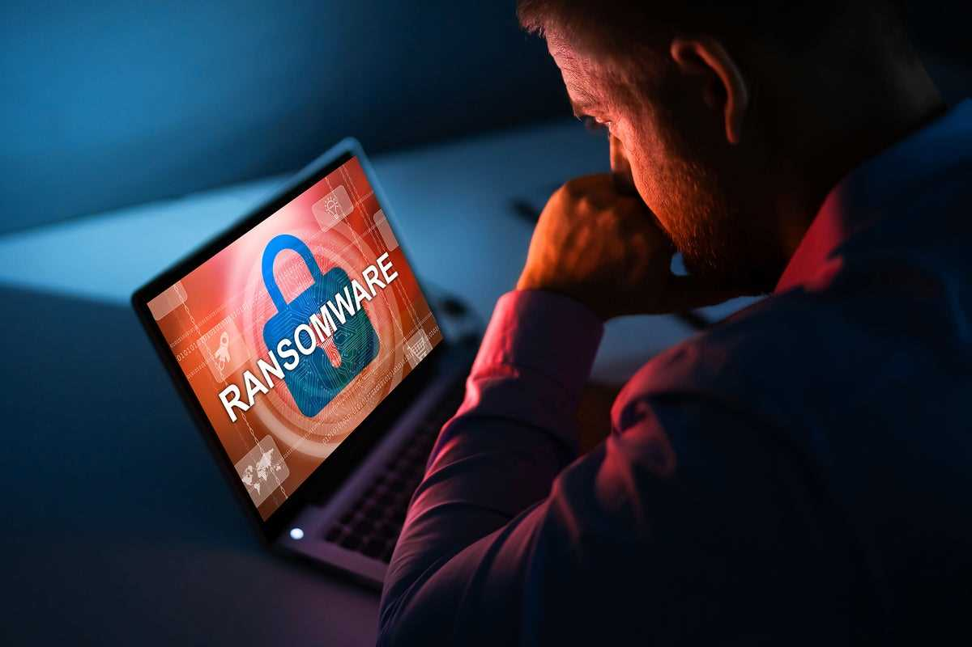
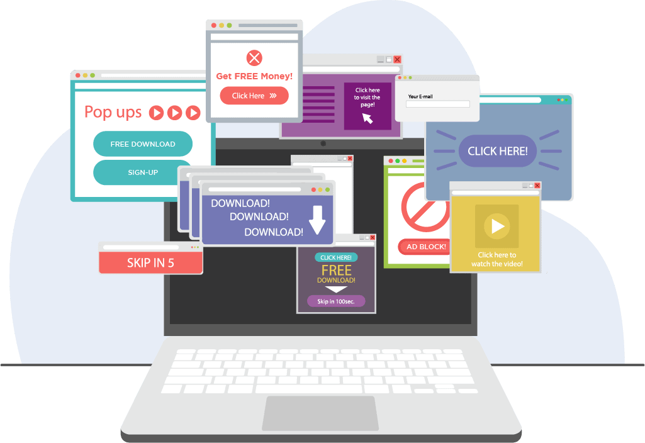
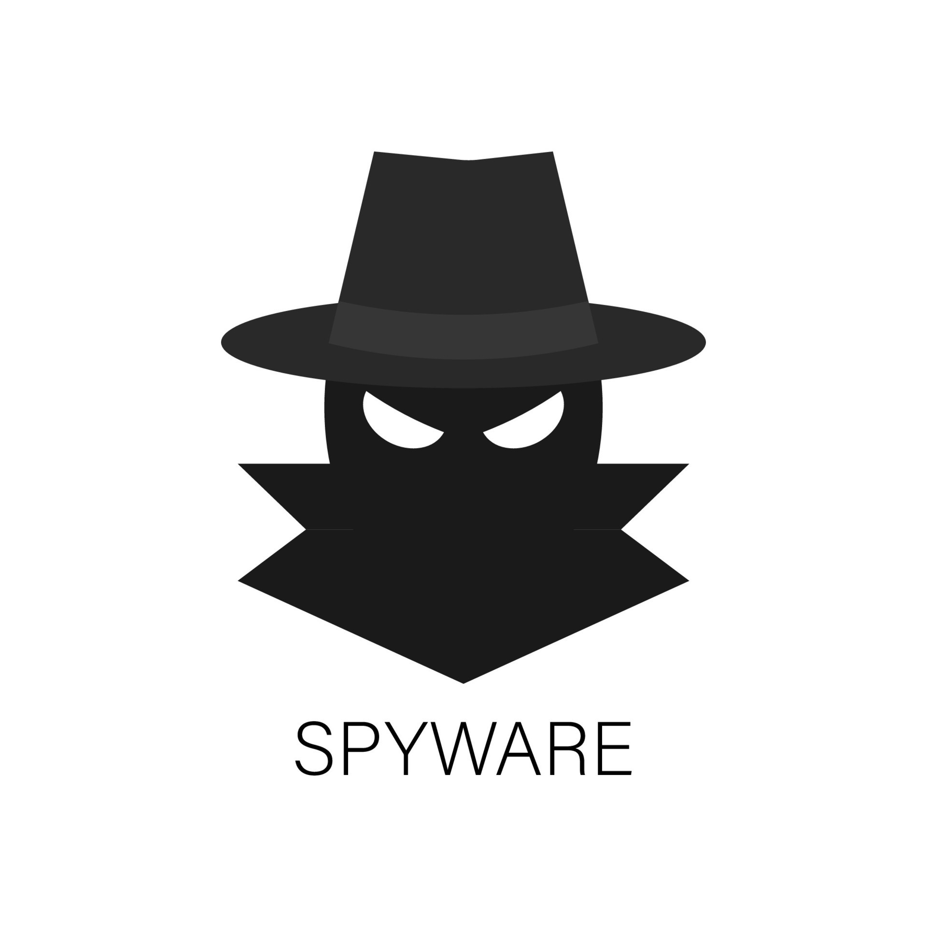
Types Of Malware
Ransomware
Adware
Spyware

Slide 5
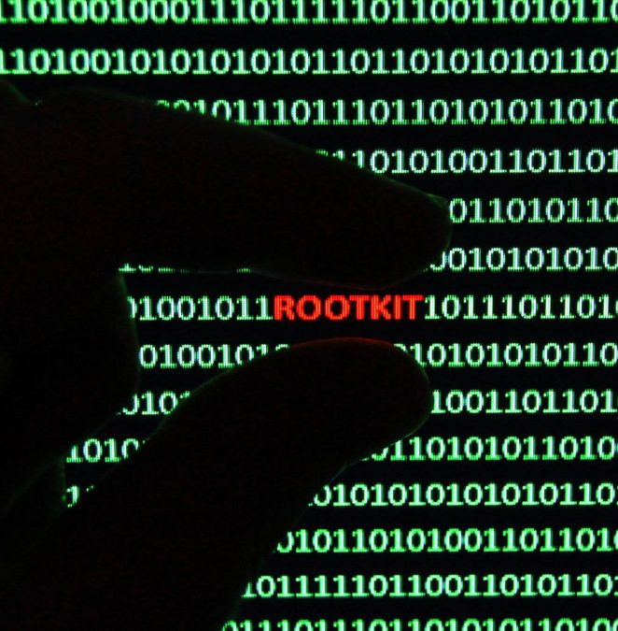
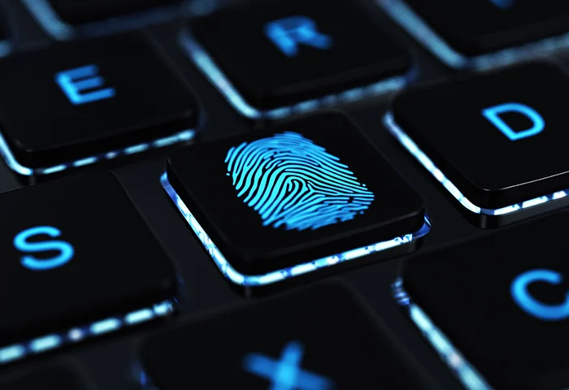

Types Of Malware
Rootkits
Keylogger
Malicious cryptomining

Slide 6
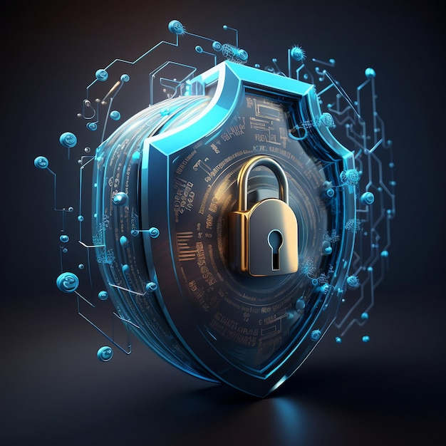
Malware Analysis
Malware analysis involves dissecting malicious software to understand its structure, behavior, and impact. The goal is to identify its characteristics, origin, and functionality to mitigate its threat and prevent future attacks. This process includes various types of analysis, best practices, and key stages that help in comprehensively understanding and neutralizing malware threats.

Slide 7
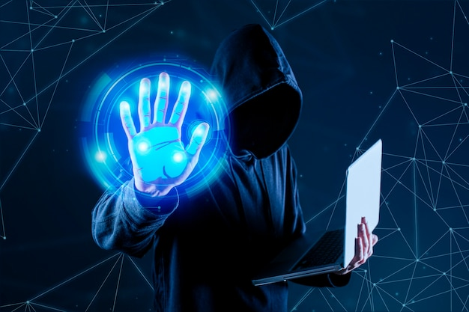
Type of Malware Analysis
Static Malware Analysis
Examines malware files without executing the code, identifying harmful elements like filenames, IP addresses, and domains using tools like network analyzers.
Dynamic Malware Analysis
Involves running the malware in a sandbox—an isolated virtual environment—allowing safe observation of its behavior without risking system infection.

Slide 8
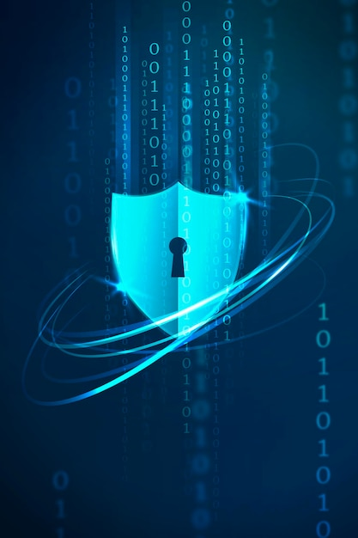
Stages of Malware Analysis
01
Static properties analysis
02
Interactive behavior analysis
03
Fully automated analysis
04
Manual code reversing

Slide 9
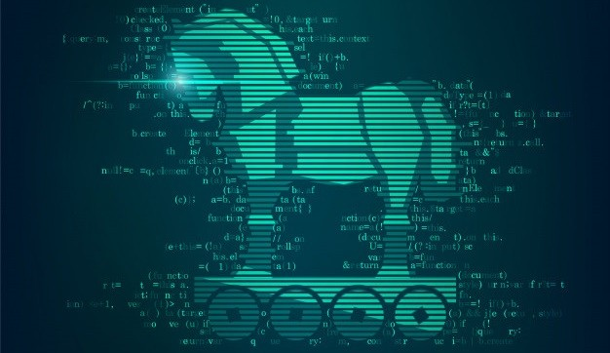
What’s a Trojan
A Trojan is a type of malware that hides within a legitimate file or program to gain access to your device. Because Trojan malware is delivered inside a legitimate app or file, it’s very difficult to detect. Trojans are used to spy on victims, steal data, infect other programs, and inflict other harm.

Slide 10
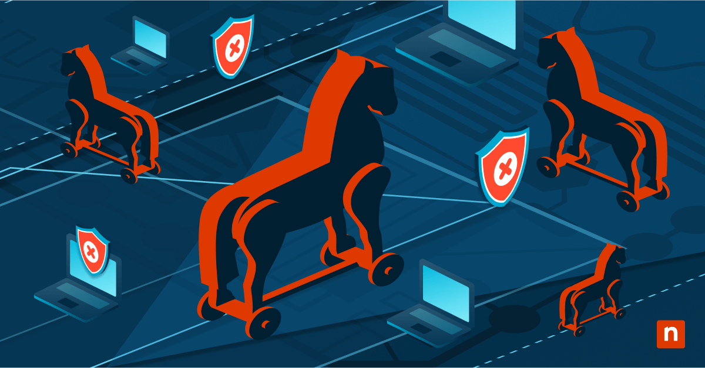
Types of Trojans
Backdoor Trojans
Remote Access Trojan (RAT)
Banking Trojans
DDoS Trojan

Slide 11

How do Trojans actually work?
Trojans work by disguising themselves as legitimate software or files to trick users into downloading and installing them. Once installed, they create a backdoor that allows attackers to remotely control the infected device. Trojans can steal data, monitor user activity, or even install additional malware without the user's knowledge. Unlike viruses or worms, Trojans do not self-replicate.

Slide 12
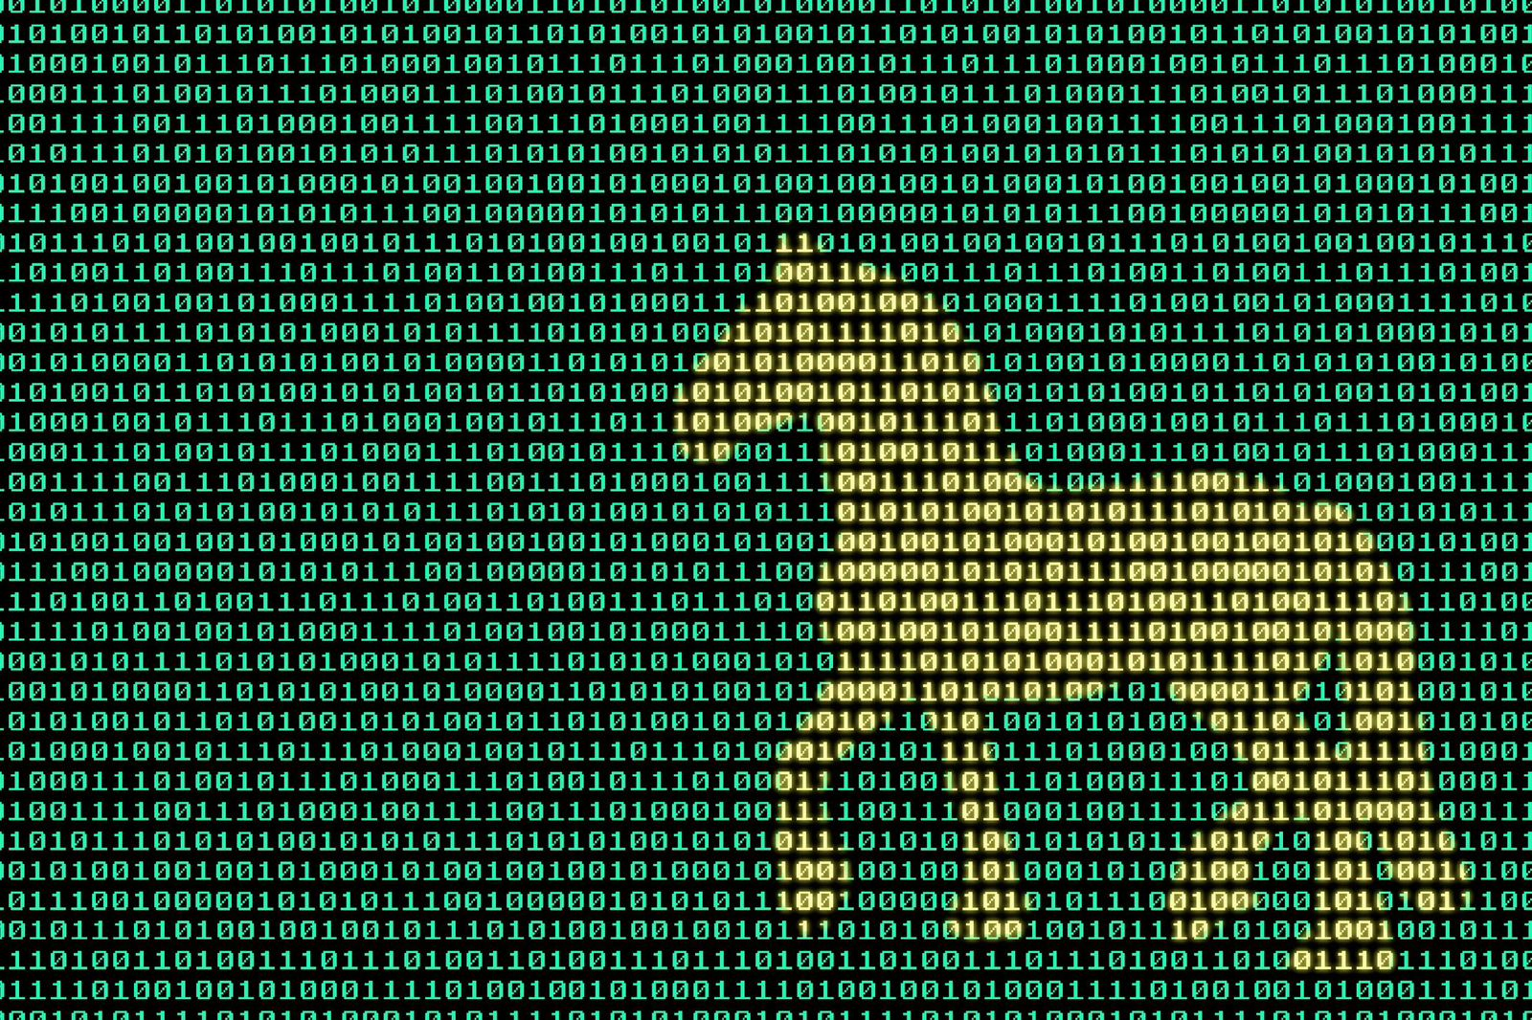
Prevention and Mitigation of Trojans
Use Antivirus and Anti-Malware Software
Do not download from untrusted sources
Avoid phishing assaults
Update your Operating framework and any introduced security conventions
Do not visit dangerous sites

Slide 13
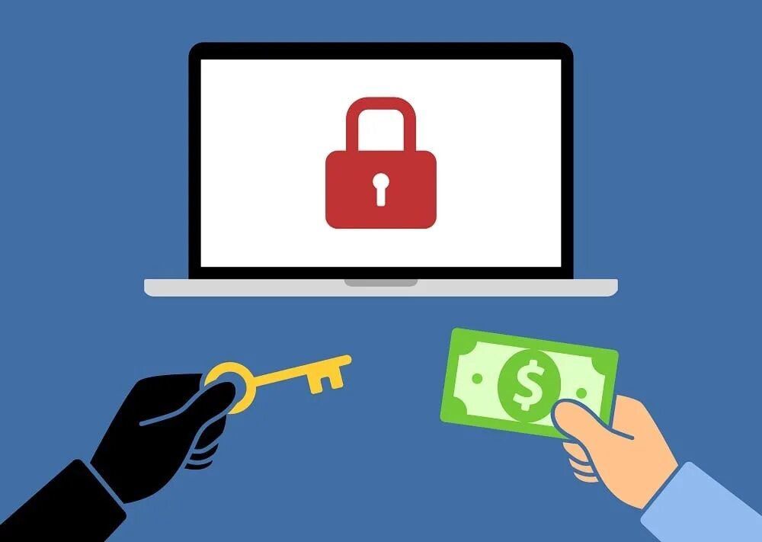
What’s ransomware
Ransomware is a type of malware that holds a victim’s sensitive data or device hostage, threatening to keep it locked—or worse—unless the victim pays a ransom to the attacker . The earliest ransomware attacks simply demanded a ransom in exchange for the encryption key needed to regain access to the affected data or use of the infected device

Slide 14
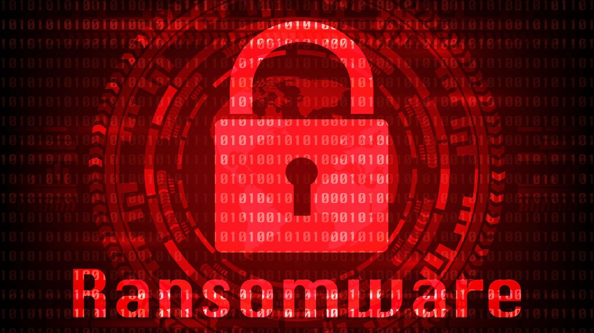
Types of ransomware
Leakware or doxware
Mobile ransomware
Wipers
Scareware

Slide 15
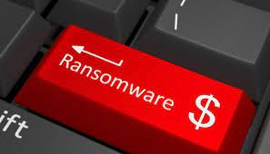
How does Ransomware actually work?
Ransomware infiltrates a system through phishing emails, malicious links, or software vulnerabilities. Once inside, it encrypts files, making them inaccessible to the user. The attacker demands a ransom, usually in cryptocurrency, in exchange for a decryption key. If the ransom isn’t paid, the attacker may threaten to delete or leak the data. Ransomware can also spread across networks, affecting multiple devices or systems.

Slide 16
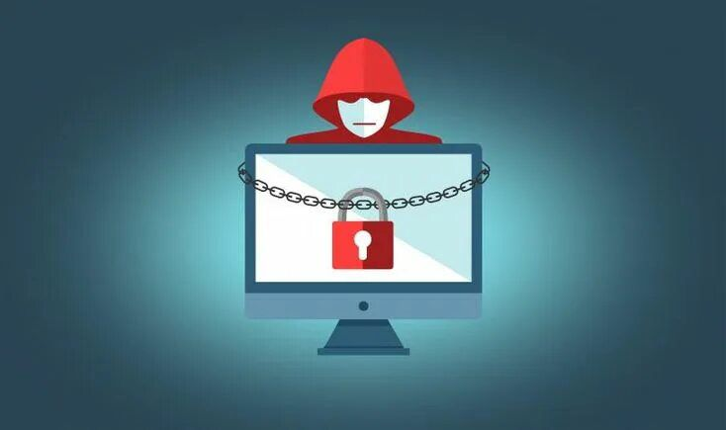
Prevention and Mitigation of Ransomware
Never click on unverified links
Scan emails for malware
Use firewalls
Only download from trusted sites
Keep backups of important data
Use security software
Do not use unfamiliar USB devices
Avoid giving out personal data

Slide 17
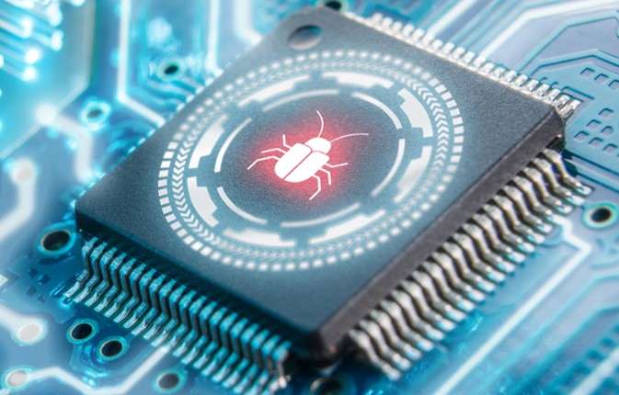
What’s a rootkit
A rootkit is a type of malicious software designed to gain unauthorized access to a computer or network while hiding its presence. It typically allows attackers to maintain control over the system, manipulate processes, and access sensitive data without detection. Rootkits can modify system files and processes, making them difficult to identify and remove, and can be used to facilitate other types of malware or attacks.

Slide 18
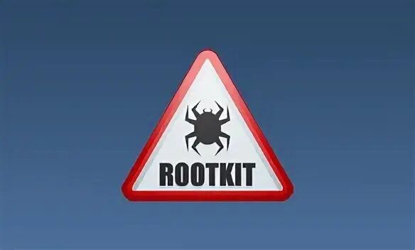
Types of rootkits
User-Mode Rootkits
Kernel-Mode Rootkits
Bootloader (Bootkit) Rootkits
Firmware Rootkits
Hypervisor Rootkits (Virtualized Rootkits)

Slide 19
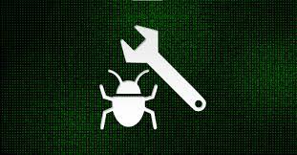
How does Rootkits actually work?
Rootkits are malicious software that install themselves deeply in the operating system, often at the kernel level. They gain administrative access, allowing them to bypass security measures. Rootkits conceal their presence by modifying system files and processes, making detection difficult. Once installed, they can monitor user activities, log keystrokes, and execute commands remotely, while ensuring persistence by running automatically at system startup.

Slide 20
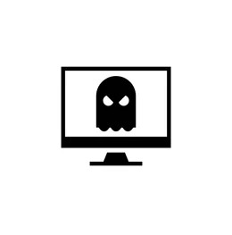
Prevention and mitigation
Behavioral Analysis
File Integrity Monitoring (FIM)
Boot-Time Scans
Hardware-Based Detection
Digital Signatures

Slide 21

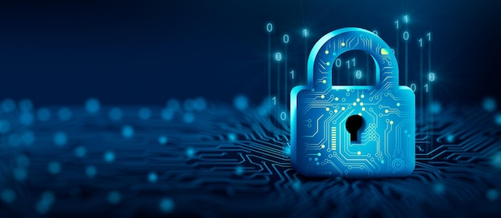
What are SIEM Solutions?
01
Security Information Management (SIM)
Security Information and Event Management (SIEM) is a comprehensive approach to managing an organization's security posture. A SIEM solution combines two critical cybersecurity functions
02
Security Event Management (SEM)

Slide 22
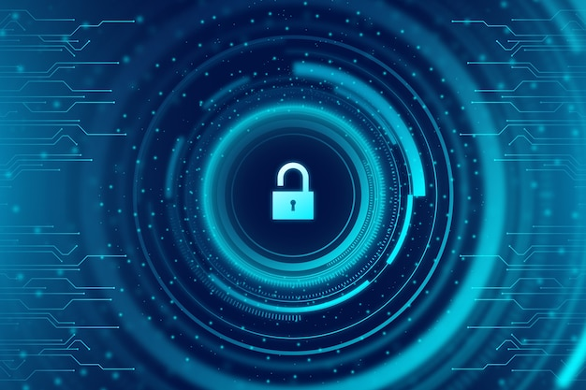
How SIEM correlate with EDR, windows & linux logs ?
SIEM solutions correlate data from Endpoint Detection and Response (EDR) systems and Windows/Linux logs to provide comprehensive security monitoring and threat detection. Here's how they work together:
01
02
03
Data Collection
Log Normalization
Correlation
04
05
Threat Detection & Response
Incident Analysis

Slide 23
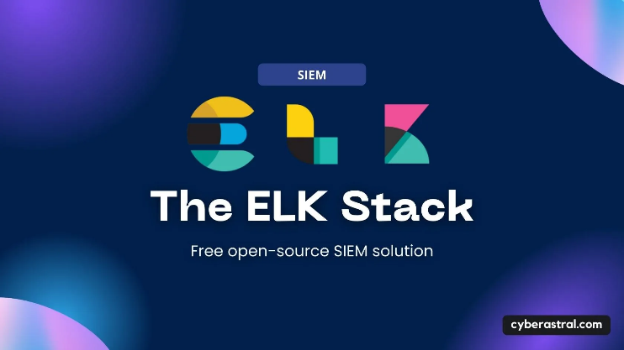

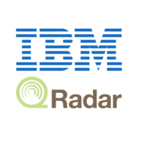
SIEM Products
There are several SIEM products on the market, like Splunk, IBM QRadar, ELK (Elastic), and Sophos. We chose Elastic SIEM for its cloud-based nature, eliminating the need for local storage and high-performance hardware like IBM QRadar. Additionally, its pre-configured architecture saves us the time and effort required by Splunk, making it the best fit for our needs

Slide 24
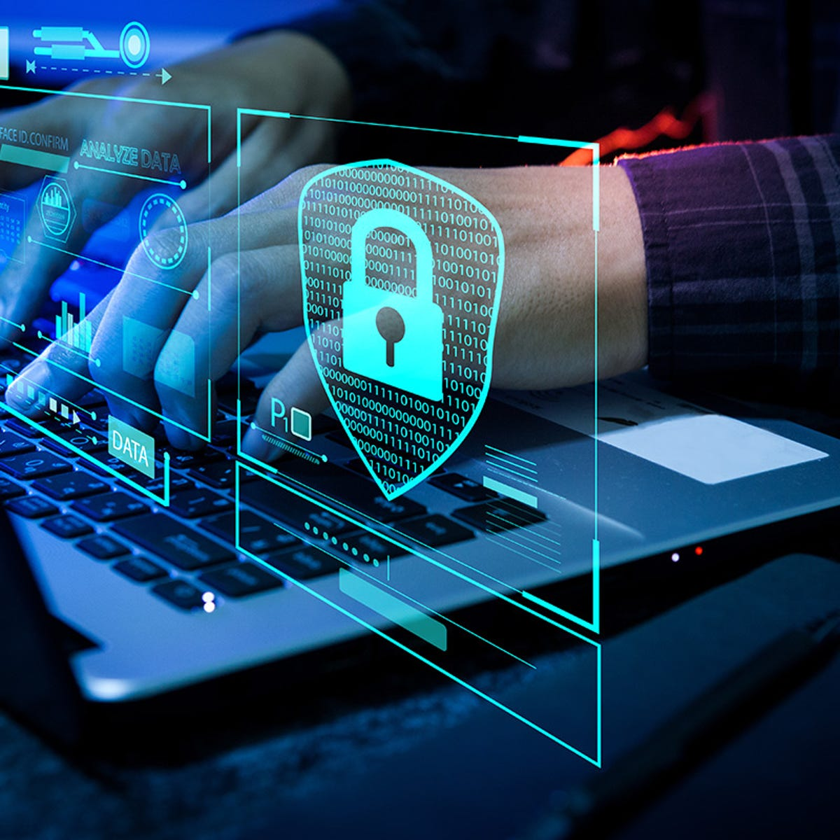
Elk Configuration
After mapping various malware types to the MITRE ATT&CK framework, we implemented the ELK stack (Elasticsearch, Logstash, Kibana) as our SIEM solution. It was configured to efficiently monitor and detect potential malware activities across our infrastructure.

Slide 25
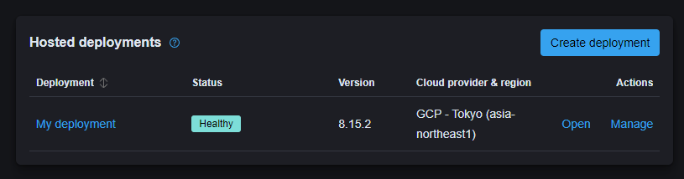
1. Cloud Deployment Strategy
We opted for a cloud-based deployment on Google Cloud Platform (GCP), specifically selecting the Tokyo region to optimize latency and comply with data residency requirements. This decision provided us with the scalability and reliability necessary for enterprise-wide security monitoring.

Slide 26
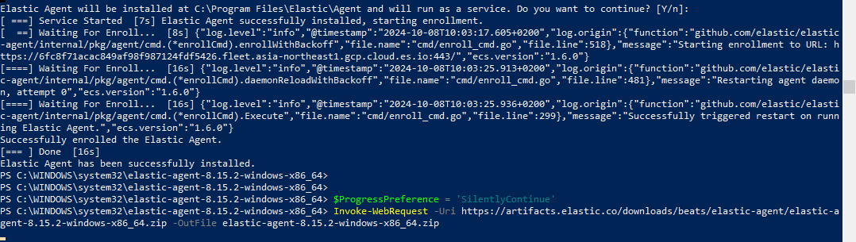
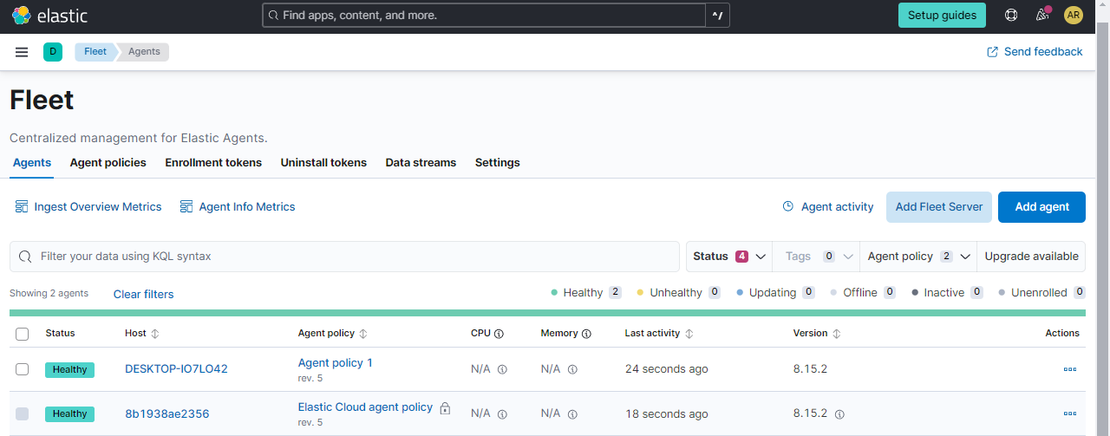
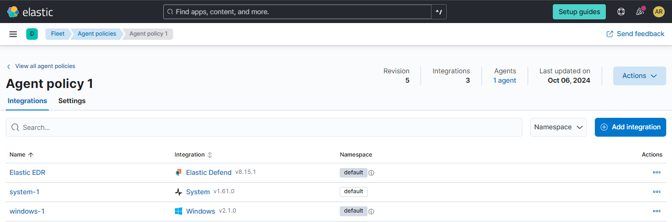
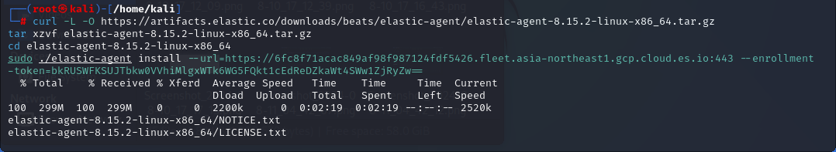
2. Endpoint Integration
The integration of endpoints with our SIEM solution involved a systematic approach across different operating systems
1 ) Fleet Management Setup
2 ) Critical Integrations

Slide 27
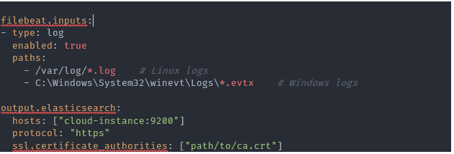
3. Filebeat Implementation and Troubleshooting
During our deployment, we encountered significant challenges with log collection from endpoints. The initial configuration failed to properly forward logs to our cloud-based SIEM solution. To resolve this, we implemented Filebeat as an additional component

Slide 28
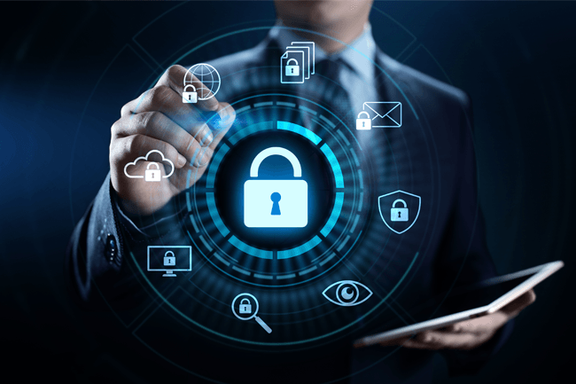
4. Integration Validation
Confirming log receipt in Elasticsearch
Verifying proper log parsing and indexing
Testing alert configurations
Ensuring real-time monitoring capabilities

Slide 29
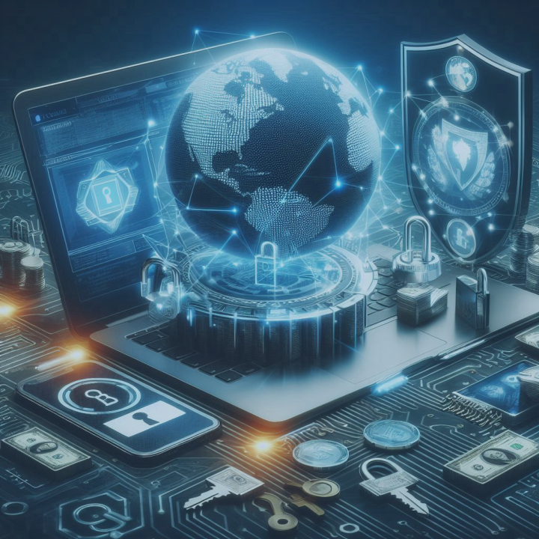
How Does Malware Spread?
01
Infected Attachments
02
Compromised Websites
03
Downloads
USB Drives
04
05
Image

Slide 30
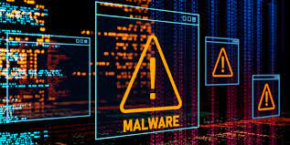
What Can Malware Do?
01
Steal personal information
02
Control your computer remotely
03
Damage or delete files
04
Disrupt or slow down your computer or network
05
Demand ransom

Slide 31
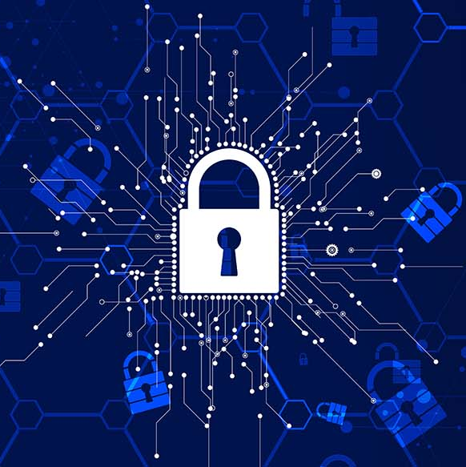
How to Protect Yourself
01
Use antivirus software
02
Keep software up to date
03
Be careful with downloads and emails
04
Back up your data
05
Use strong, unique passwords

Slide 32
Real-World Example 1 – WannaCry Ransomware Attack
Attack: In 2017, the WannaCry ransomware attack hit over 200,000 computers in 150 countries.
How It Spread: It used a vulnerability in Windows systems to infect machines and encrypt files, then demanded a ransom in Bitcoin.
Impact: Hospitals, businesses, and government institutions were severely disrupted.
Lesson: Always update software—WannaCry exploited an unpatched Windows vulnerability.

Slide 33
Real-World Example 2 – NotPetya Ransomware
Attack: The NotPetya attack in 2017 looked like ransomware but was actually designed to destroy data.
How It Spread: It used the same vulnerability as WannaCry but was aimed at maximum disruption, particularly in Ukraine.
Impact: Large corporations such as shipping giant Maersk, pharmaceutical
company Merck, and others experienced major losses, totaling billions.
Lesson: Even trusted-looking software (it spread via accounting software) can carry hidden threats.

Slide 34
Real-World Example 3 – The Stuxnet Worm
Attack: Stuxnet, a worm discovered in 2010, was designed to target and sabotage Iran’s nuclear program.
How It Spread: It spread via USB drives and targeted industrial control systems.
Impact: It specifically altered the functioning of centrifuges in Iran’s nuclear facilities, causing physical damage.
Lesson: Malware can be used for cyber warfare, targeting not just data but physical infrastructure.

Slide 35
Real-World Phishing Campaign – The 2016 Podesta Email Phishing Attack
Attack: In 2016, during the U.S. presidential campaign, John Podesta, a key figure in Hillary Clinton’s campaign, fell victim to a phishing attack.
How It Worked: Podesta received a fake email that looked like a Google alert for a password reset. When he clicked the link, it led to a fake Google login page, where his credentials were stolen.
Impact: The stolen emails were leaked to WikiLeaks, causing political embarrassment and disruption.
Lesson: Be cautious with unexpected password reset emails and always verify the source before entering credentials.

Slide 36
Real-World Phishing Campaign – Operation Phish Phry
Attack: Operation Phish Phry was a massive phishing campaign discovered by the FBI in 2009.
How It Worked: Criminals sent fake bank emails to U.S. and Egyptian citizens, tricking them into entering their online banking credentials on fake websites.
Impact: The criminals stole millions of dollars from compromised accounts. It resulted in the largest cybercrime investigation at the time, with over 100 arrests.
Lesson: Never click on suspicious links in bank emails and always verify websites before entering sensitive information.

Slide 37
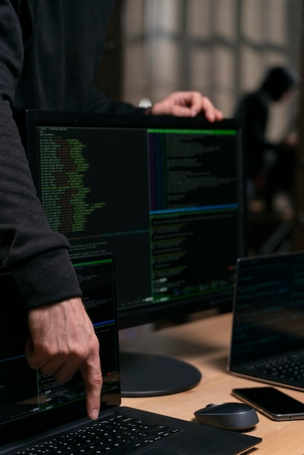
Conclusion
This research highlights the importance of understanding malware not only for creating more effective security measures but also for recognizing potential vulnerabilities within systems. Our practical analysis of malware in controlled environments demonstrates how critical it is to have proactive defense strategies to prevent attacks and minimize the impact of infections.

Slide 38
Thank You!

